Slide 1
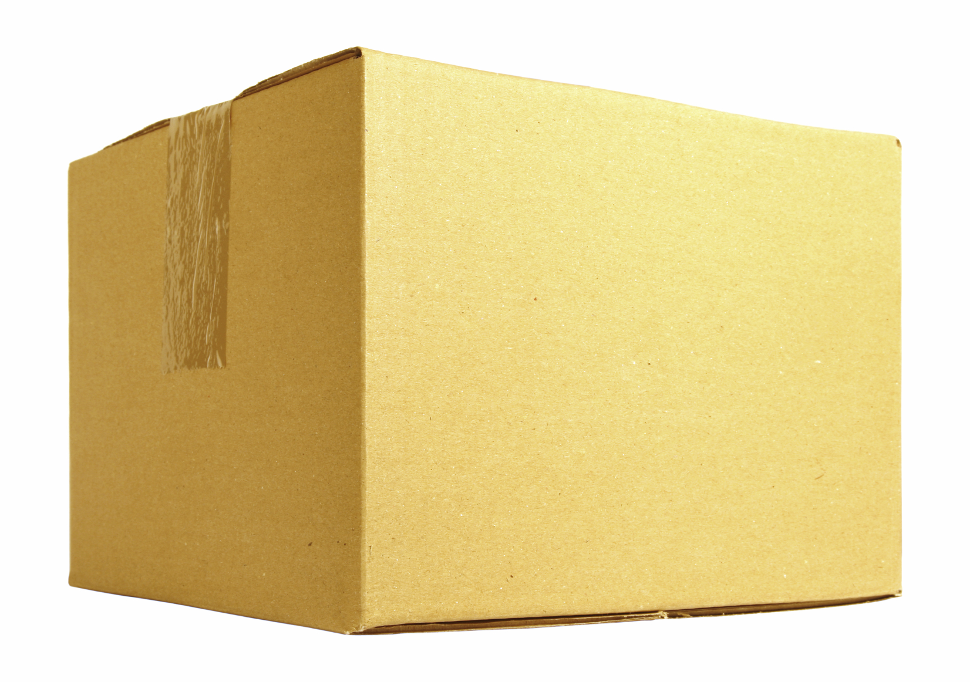
Autonomous Delivery Robot
Team: Thomas Clement, Ryan Schuller, JD Severtson, Sara Danenhower, Devin Baldi

Slide 2
Progress So Far
The student team has met for an initial meeting
Sara is the temporary customer/mentor liaison
She has contacted Dr. Mohr to schedule a meeting for later this week

Slide 3
Technical Details
Uber has donated a VLP-16 Lidar Unit for this project
Key Features
Lightweight (830 g)
Low power consumption (8W)
Compact (103mm x 72mm)
International Electrotechnical Commission (IEC) Class 1 Eye Safe
IEC IP-67 rated
Wide Temperature Range (-10 C – 60 C) (14 F – 140 F)

Slide 4
References
https://www.mapix.com/lidar-scanner-sensors/velodyne/velodyne-puck-vlp16/ accessed 9/7/2020
https://en.wikipedia.org/wiki/Laser_safety#Class_1 Accessed 9/7/2020
https://en.wikipedia.org/wiki/IP_Code#cite_note-NE_Laser-5 Accessed 9/7/2020

